Slide 1
Social Media Complaint workflow automation tool using sentiment intelligence
Shubham Varshney | Prakhar Dogra | Vikrant Dabas | Vikas Maviya
Department of Computer Science and Engineering Delhi Technological University

Slide 2
Table of Contents
S. No. | Topic
1 | Our Motivation
2 | Our Goal
3 | Why Facebook?
4 | System Architecture
5 | Implementation
6 | Applications
7 | Future Work

Slide 3
Our Motivation
A vital part of the information era has been to find out the opinions of other people and we can automate the sentiment analysis of said information.
Our main motivation came from a personal experience with one of the customer feedback forums of a Travel Agency.
We wanted to reduce the amount of time it took analyze the customer feedback.
Notes:
Give AAP example here

Slide 4
Our Goal
The goal of our research was to do sentiment analysis of posts using various probabilistic classification algorithms.
The main idea of the research was to create a model that is able to predict the type of post. Either a complaint or a positive feedback or a query.
Automated complaint capture, receipt and extraction of information required to process each individual complaint, whether it was originally received on paper, email, social media, fax or another electronic format

Slide 5
Why select Facebook?
It is used by people of different domains to express their views and opinions about services received.
It contains sheer amount of text posts that grows at large rates everyday.
It is used by people from many countries.
The length of Facebook posts is very large as compared to Twitter posts.
The Twitter had very few instances of legitimate complaints/positive feedbacks.

Slide 6
Workflow Architecture
Web crawler to download online posts
Cleaning of the posts:
Removal of Hashtags
Removal of hyperlinks
Removal of usernames
Removal of punctuations
Manually label the cleaned posts
Labelled data
Initialize the classifier
Train the classifier over the labelled data
Test the trained classifier on the labelled data

Slide 7
Crawling Facebook Graph API

Slide 8
Web crawler to download online posts
Cleaning of the posts:
Removal of Hashtags
Removal of hyperlinks
Removal of usernames
Removal of punctuations
Manually label the cleaned posts
Labelled data
Initialize the classifier
Train the classifier over the labelled data
Test the trained classifier on the labelled data

Slide 9
Preprocessing Module

Slide 10
Web crawler to download online posts
Cleaning of the posts:
Removal of Hashtags
Removal of hyperlinks
Removal of usernames
Removal of punctuations
Manually label the cleaned posts
Labelled data
Initialize the classifier
Train the classifier over the labelled data
Test the trained classifier on the labelled data

Slide 11
POS Tagging and Training the Classifier

Slide 12
Web crawler to download online posts
Cleaning of the posts:
Removal of Hashtags
Removal of hyperlinks
Removal of usernames
Removal of punctuations
Manually label the cleaned posts
Labelled data
Initialize the classifier
Train the classifier over the labelled data
Test the trained classifier on the labelled data

Slide 13
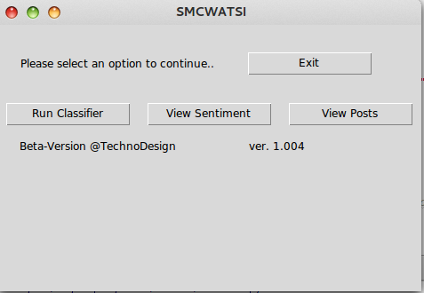

Slide 14
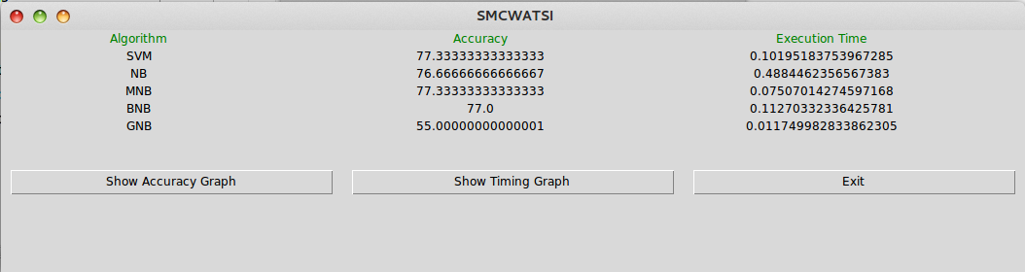

Slide 15
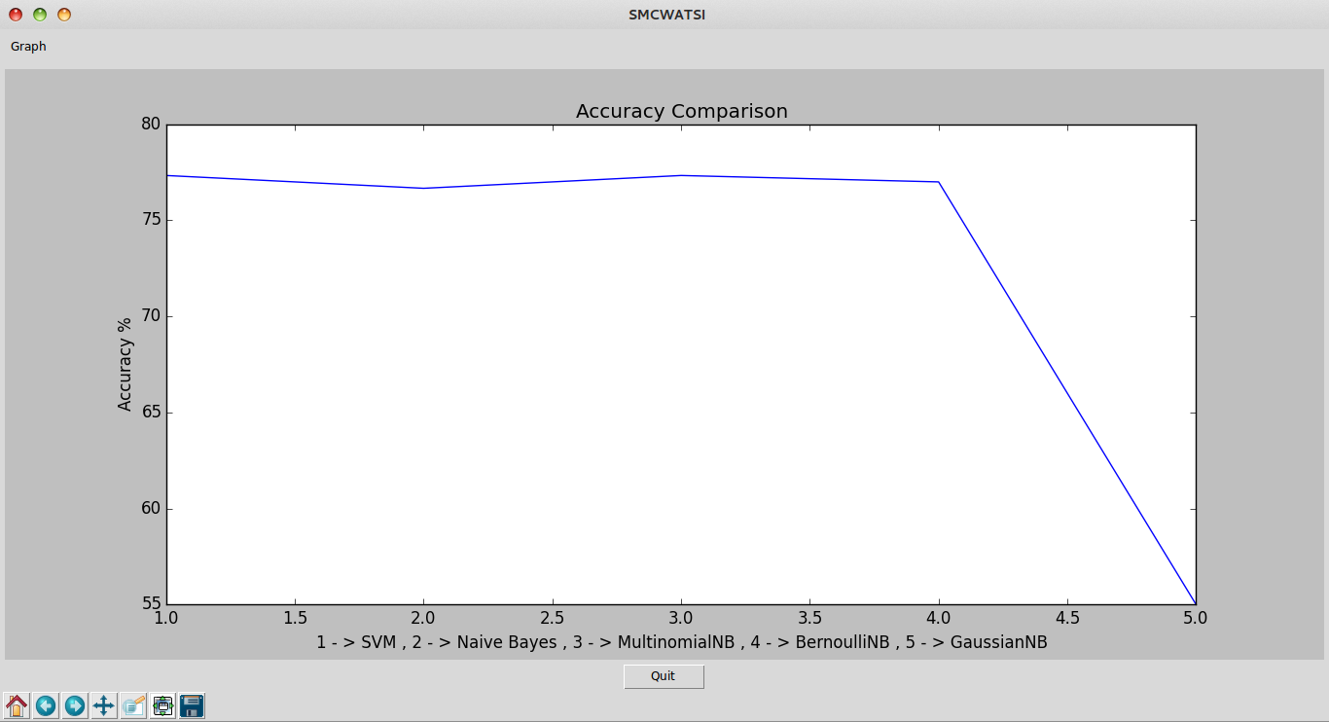

Slide 16
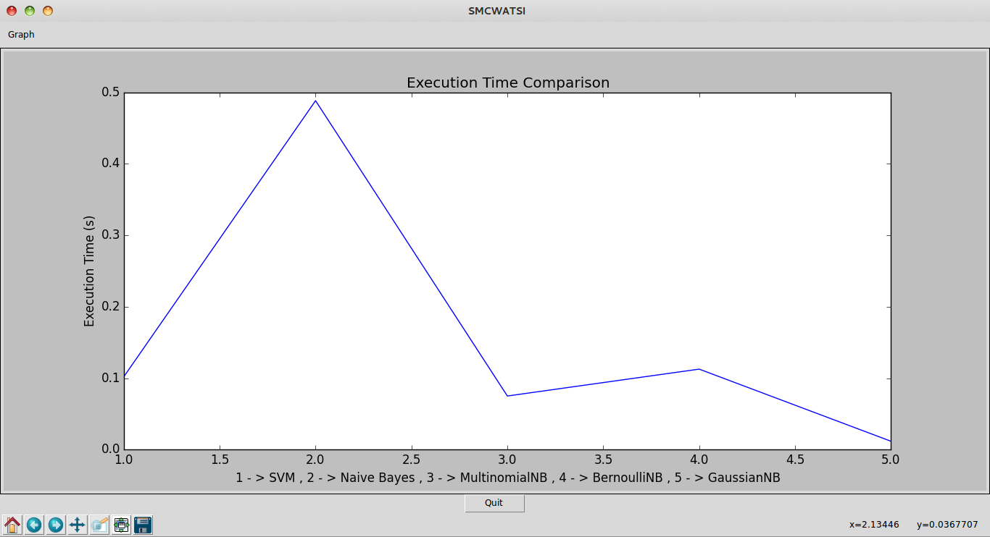

Slide 17
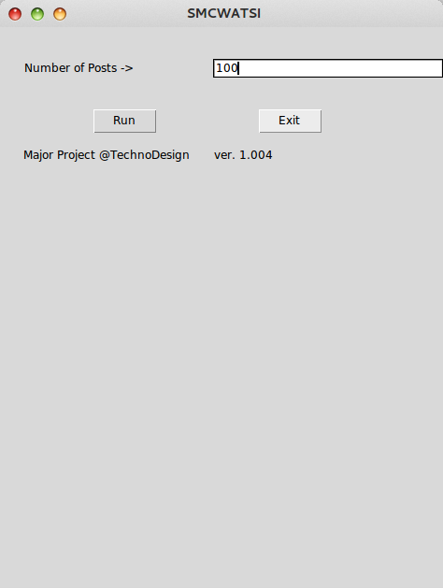

Slide 18
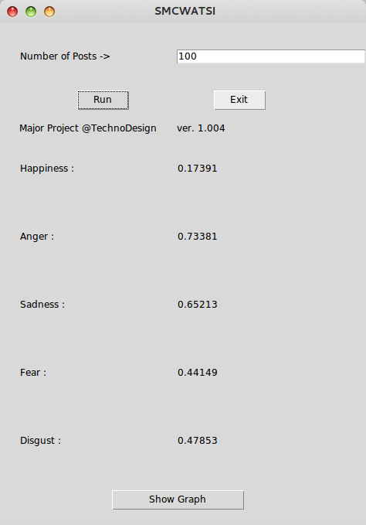

Slide 19
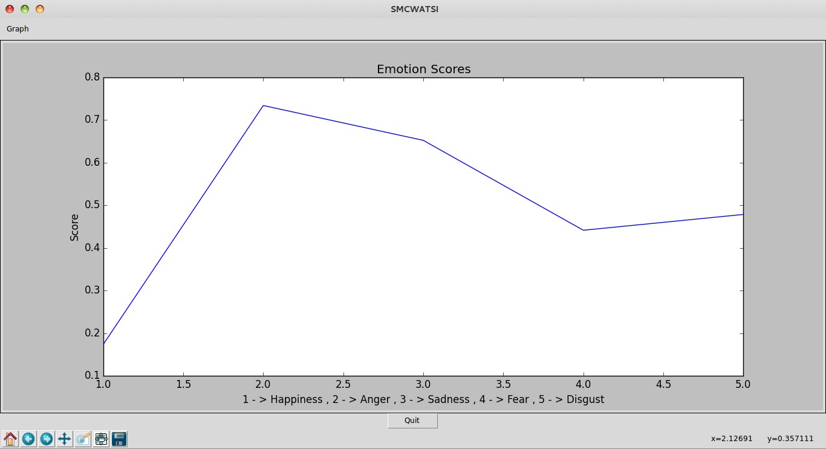

Slide 20
Applications
This model has several applications in:-
Customer feedback and complaint classification of online posts on Bank webpages.
Review related websites like movie or product reviews
Business Intelligence like knowing customer opinions or trends
In knowing public opinions for political leaders and work being done by the government

Slide 21
Scope for Future Work
Following is the list of functionalities that can be added to this model:-
Department Classification
Sarcasm Detection Module
Apriori Association

Slide 22
Thank You

